Slide 1
2019 Lariat Rental plan
Arnold Ngumete

Slide 2


Objective
THE KEY GOALS ARE TO REDUCE COST AND MAXIMIZE REVENUE TO DO SO I HAVE DEVELOPED 4 STRATEGIES

Slide 3
The dataset
50 STORES
4000 CARS
$1.3 MILLION GROSS PER STORE

Slide 4
MY PRE-ANALYSIS
Cars were rented out 27% of the year
On average, the revenue created by
each car is over 8 times the cost of said car
Rental charges are sporadic. Consistent prices
on vehicles could create more revenue

Slide 5
2019 FY LARIAT RECOMMENDATIONS
Strategy 1
CLOSE DOWN LOW EARNING BRANCHES
Strategy 2
REMOVE LOW EARNING CARS FROM THE FLEET
Strategy 3
INCREASE THE RENTAL CHARGES
Strategy 4
COMBINE ALL STRATEGIES

Slide 6
Strategy 1
Close down low earning branches
closed down the 2 lowest earning branches

Slide 7
Strategy 2
REMOVE LOW EARNING CARS FROM THE FLEET. 50% OF THE CAR FLEET
Rated revenue vs cost and generated a certain score to determine which 2000 cars to remove

Slide 8
Strategy 3
Increase the rental charges
Rounded up all rental charges to the nearest Tenth

Slide 9
A Combination of strategies
Combination of all gains and losses from each strategies

Slide 10
The Real Star of the show!
Net Revenue increase of over 50% !!!

Slide 11
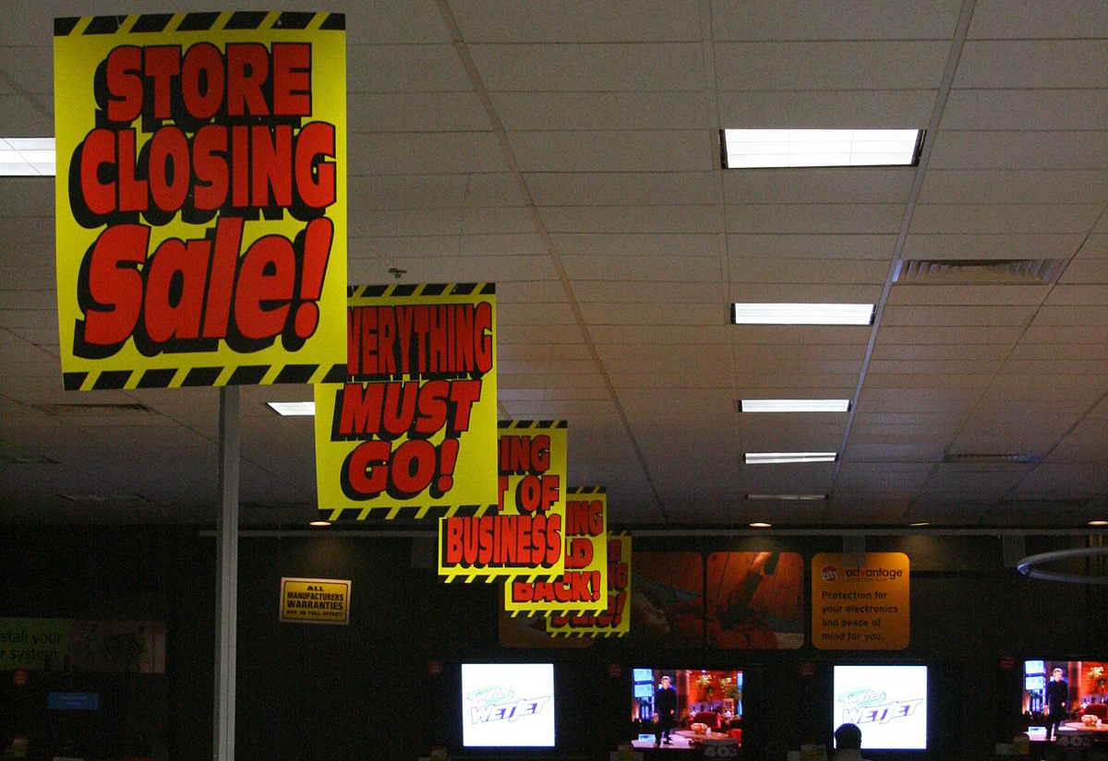
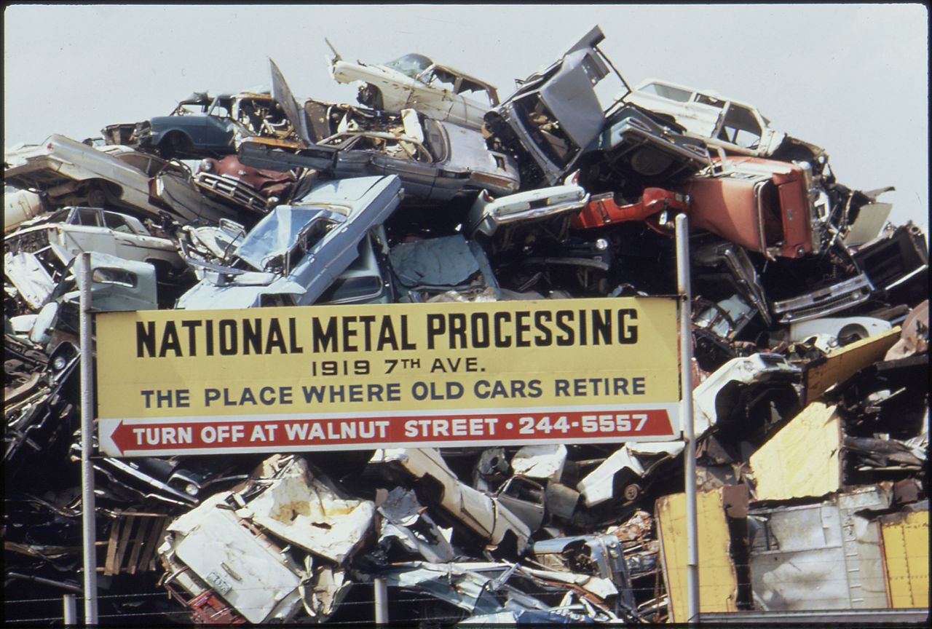
Call to action

